Slide 1
Airbnb insights report
Parkavi Srinivasa’s

Slide 2


AGENDA
INTRODUCTION
Project - goals
Key points addressed
Dashboards - walkthrough
results
Challenges

Slide 3

INTRO
Airbnb is a leading platform where people can book beds, apartments, and homes around the world. It allows the hosts to rent out their places at their convenience. Through Airbnb, people can find places to stay even in areas where there is a likelihood of fewer hotels

Slide 4
project-GOALS
Study the Airbnb data for New York City
Visualize how the Prices and ratings vary across different neighborhoods
How do the categories and other different variables influence the price and ratings?
How can we represent the available data in a meaningful pattern
How useful insights could be derived from the data

Slide 5
Data Questions
Neighborhoods that have steady growth levels based on average price
Neighborhoods constant growth based on average price by the property type
Maximum number of reviews varied based on the price ranges
Relation between the average price of the properties and the number of hosts (by neighborhood)
Percentage share - property types by room types
Different correlations derived using Host Type
Clustering & Forecasting – Model results

Slide 6
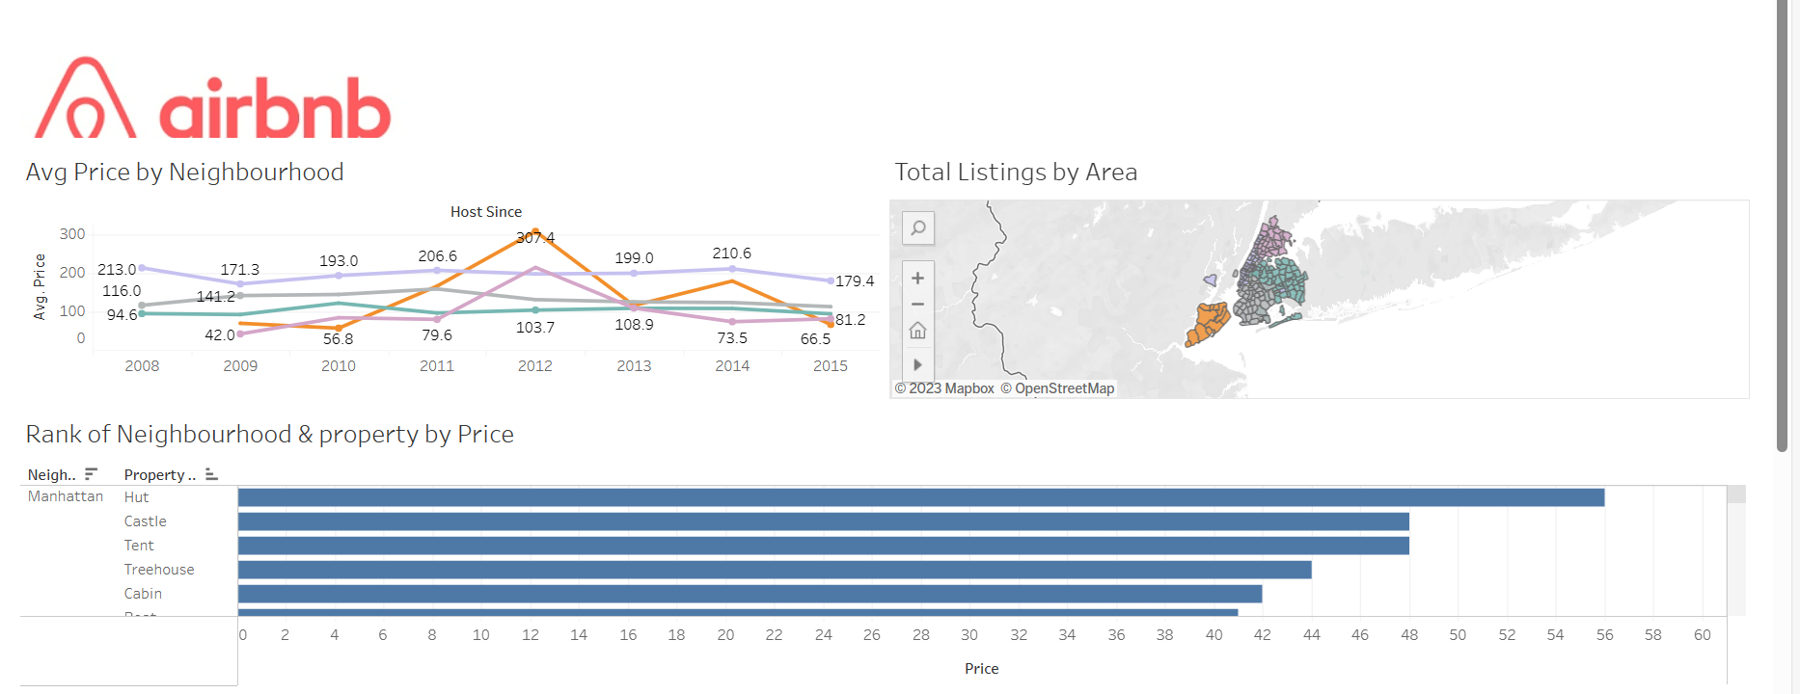
Dashboard- neighborhood
The above graph represents the neighborhoods that are having a steady growth level and stability in their business

Slide 7
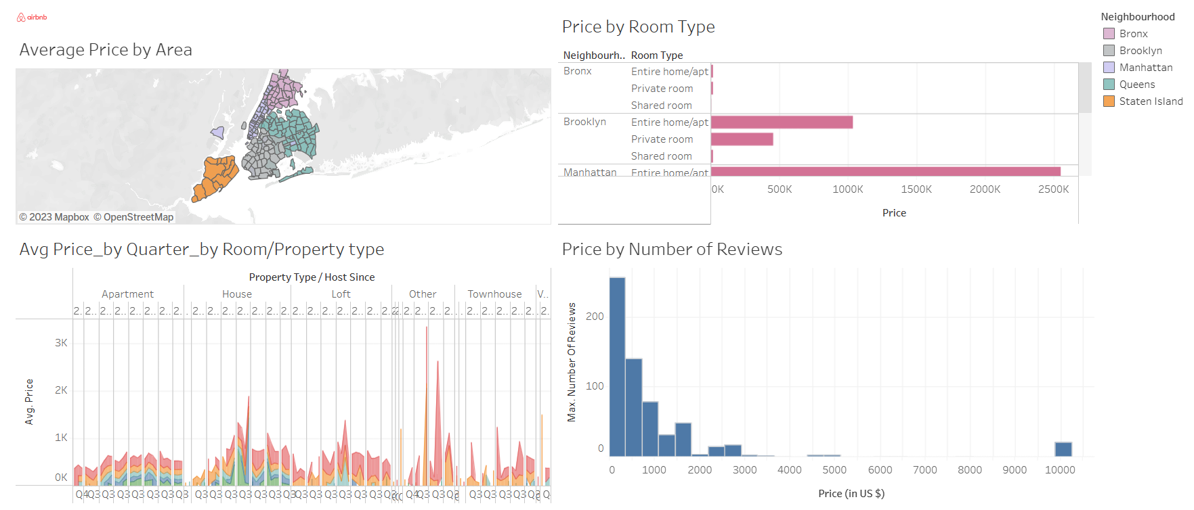
Pricing analysis-dashboard

Slide 8
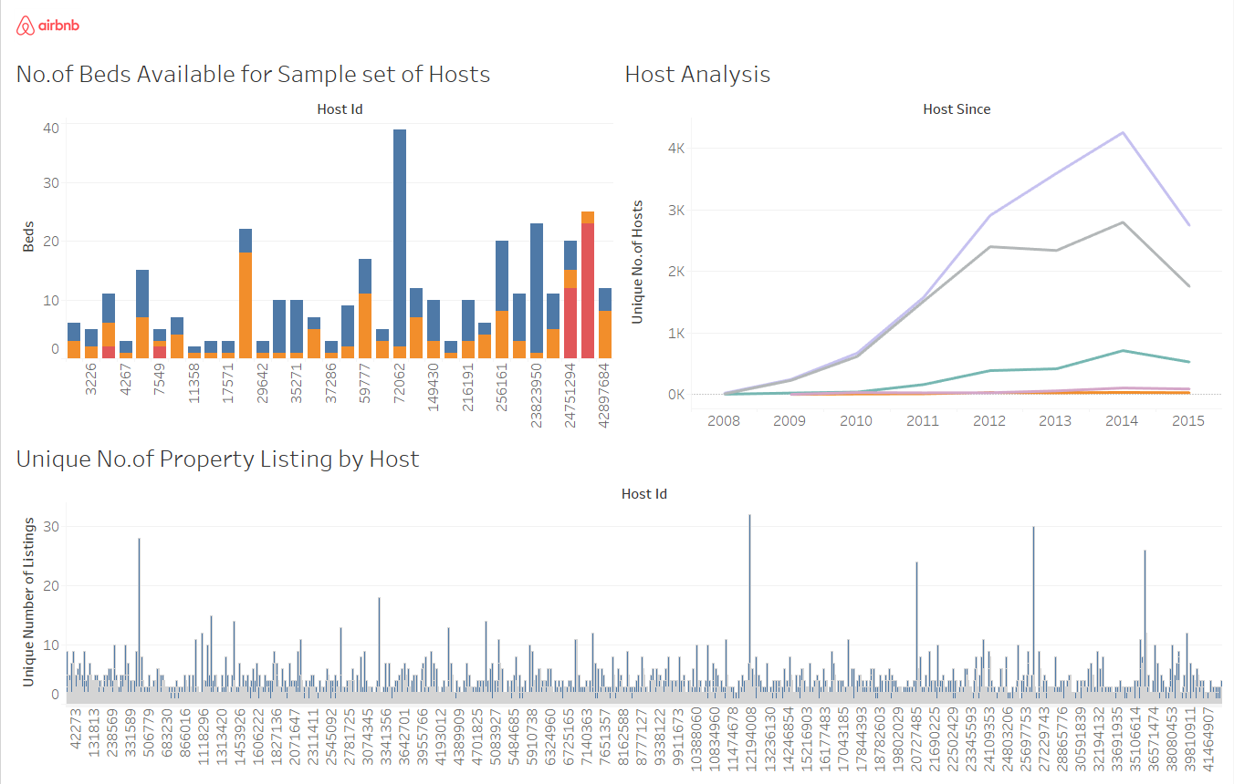
Host analysis-dashboard

Slide 9
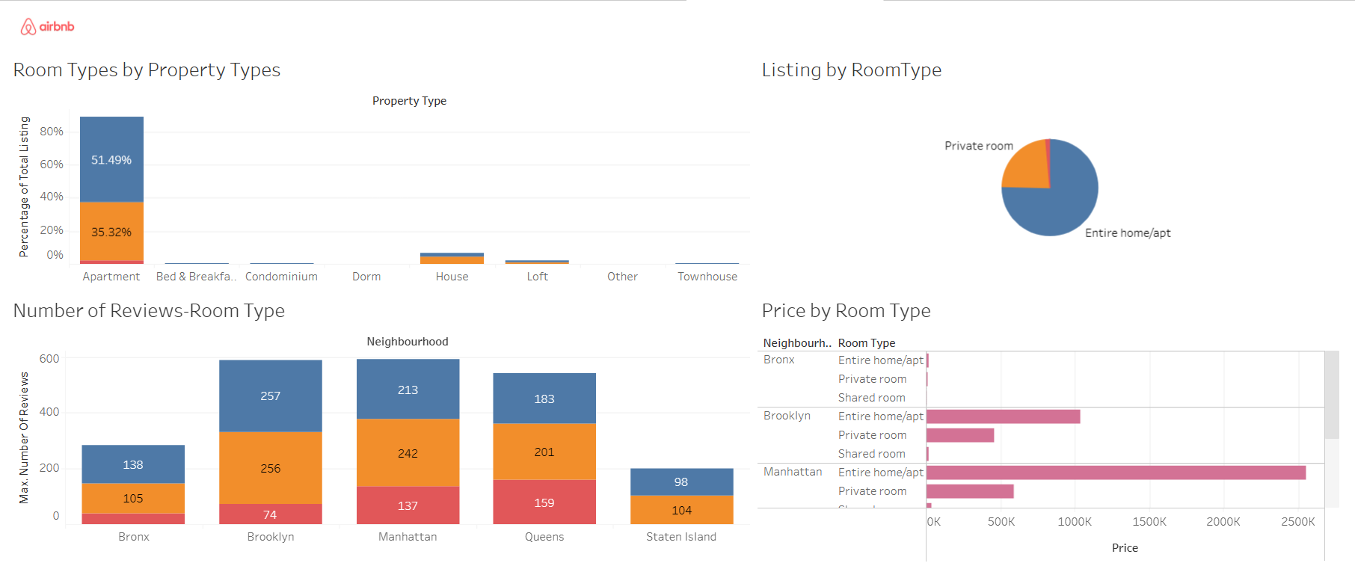
Room-type analysis-dashboard

Slide 10
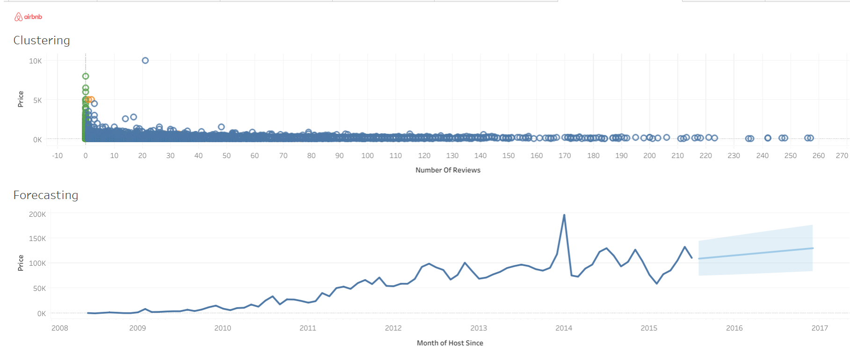
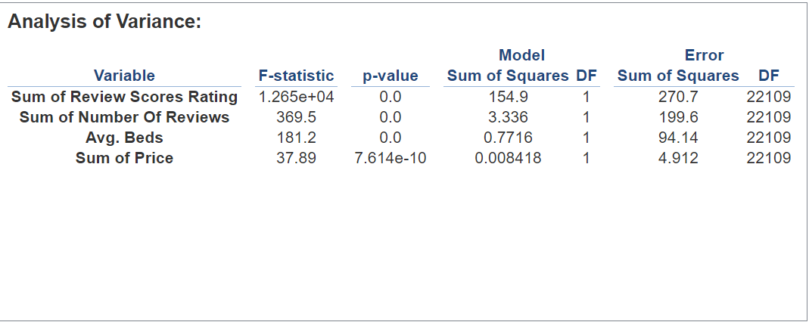
Clustering-forecasting

Slide 11
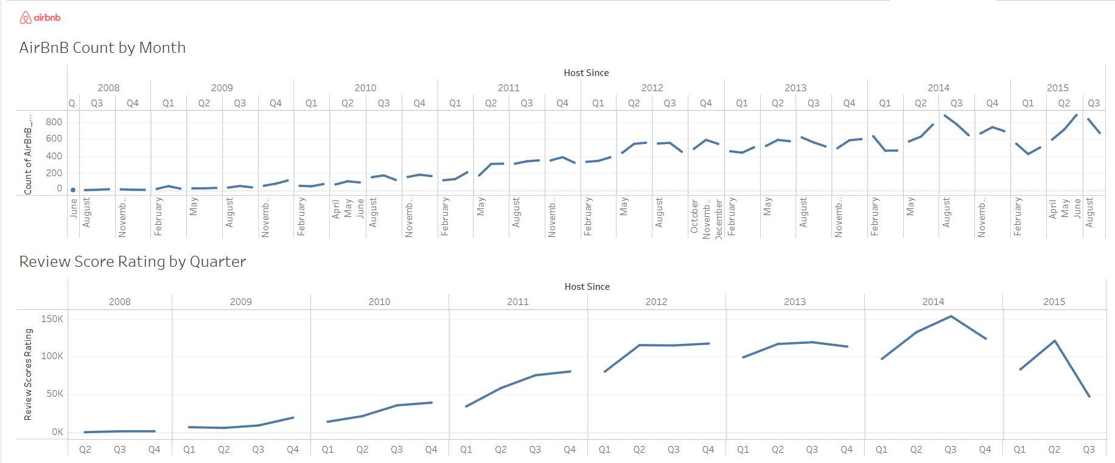
Date-time analysis

Slide 12
results
On analysis based on Avg Price by Neighborhood it looks like the Bronx has a good growth
But on analyzing the Avg Price by (Area/ Property type) it’s evident that Manhattan is a consistent player on the Price value followed by Queens and Brooklyn.
From Review by Avg Price visuals it is noted that the number of reviews decreases with an increase in the Avg Price.
Also, there are reviews only for the Price Bin of 300 to 700$ beyond which the number of reviews is very less
From the Host analysis dashboard it’s clear that there is an increase in the number of hosts from 2008 – 2014. This has a positive impact on Avg Price in Manhattan, Bronx, and Staten Island neighborhoods
From Property Type by Room type visuals, we can understand either a private room or an Entire home/ Apartment is preferred more than Shared rooms
The Clustering model results prove there is a strong correlation between the Price, Reviews, and number of beds available in a property

Slide 13

challenges
Having nulls in the date value, must skip those records during plotting of visuals
Having outliers based on the zip codes. Few zip codes – are not among the neighborhoods mentioned in the dataset
Also, had to exclude many of the records during the plotting of visuals by quarters as there are not much of property-type entries available other than few major ones

Slide 14
THANK YOU!!

